Slide 1

Experiment 2: Real-time Traffic Light
Navarro, Rod Geryk C.
CPE161P-4– C1

Slide 2
OBJECTIVES
1.To demonstrate how a traffic light works in real-time.
2. To be able apply what you have learned in logic circuits and switching theory, microprocessors, and CPE160P.
3. To be able to apply real-time embedded system using arduino kit.

Slide 3
MATERIALS
Arduino Kit
Buttons/Switches with Resistors
4-digit Seven Segment Display
LEDs
Ultrasonic Sensor
Buzzer
Laptop

Slide 4
PROCEDURE
Create a working real-time traffic light using Arduino.
To demonstrate the usage of 4-digit seven segment display, ultrasonic sensor, LEDs, and buttons.
Debug the code

Slide 5
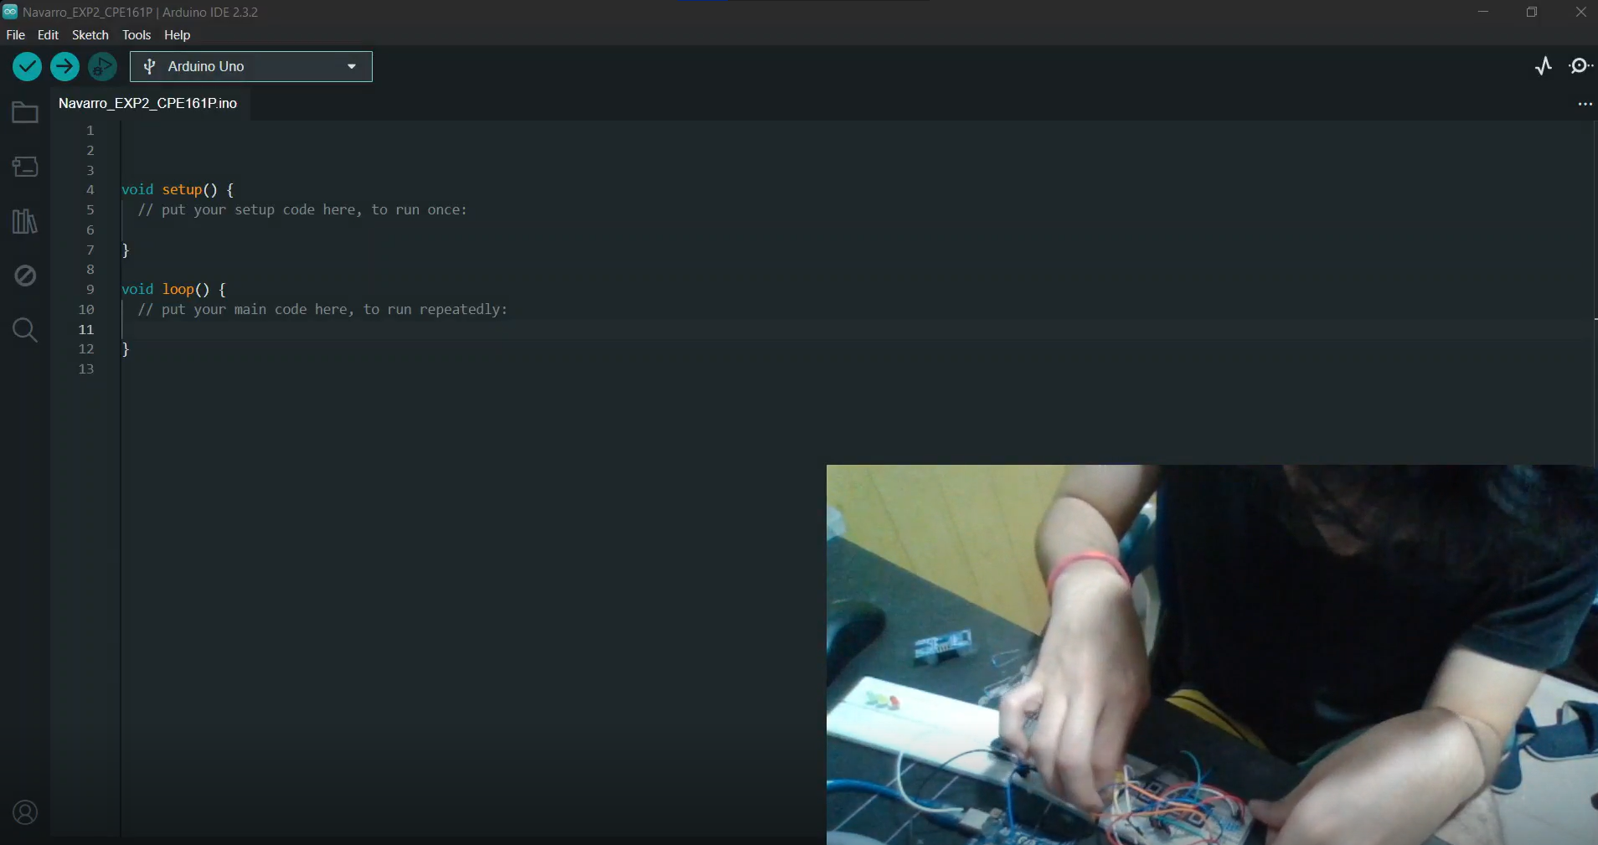
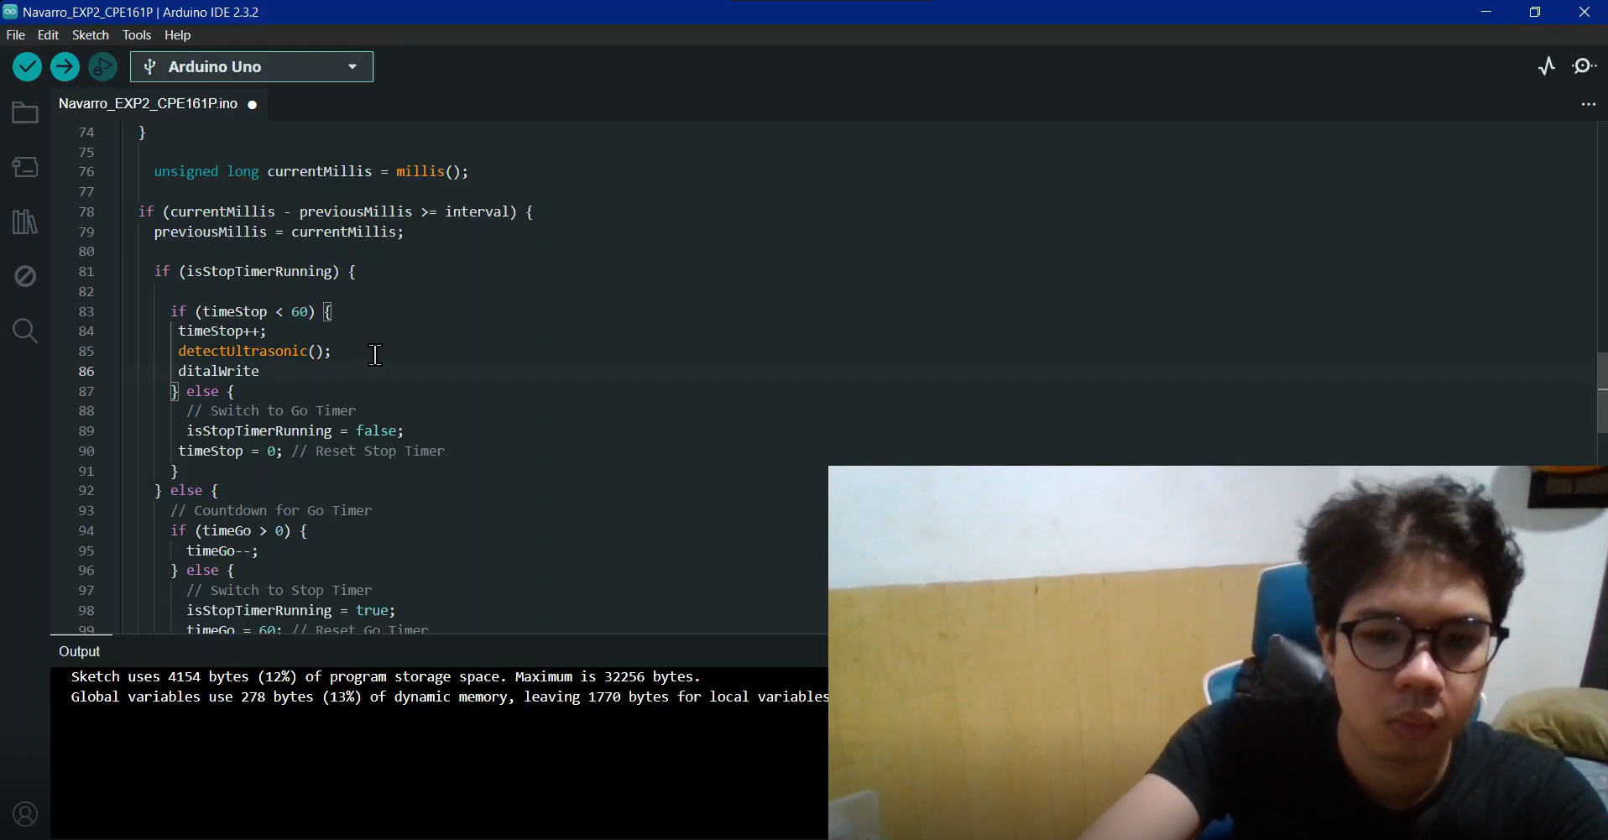
PROCEDURE

Slide 6
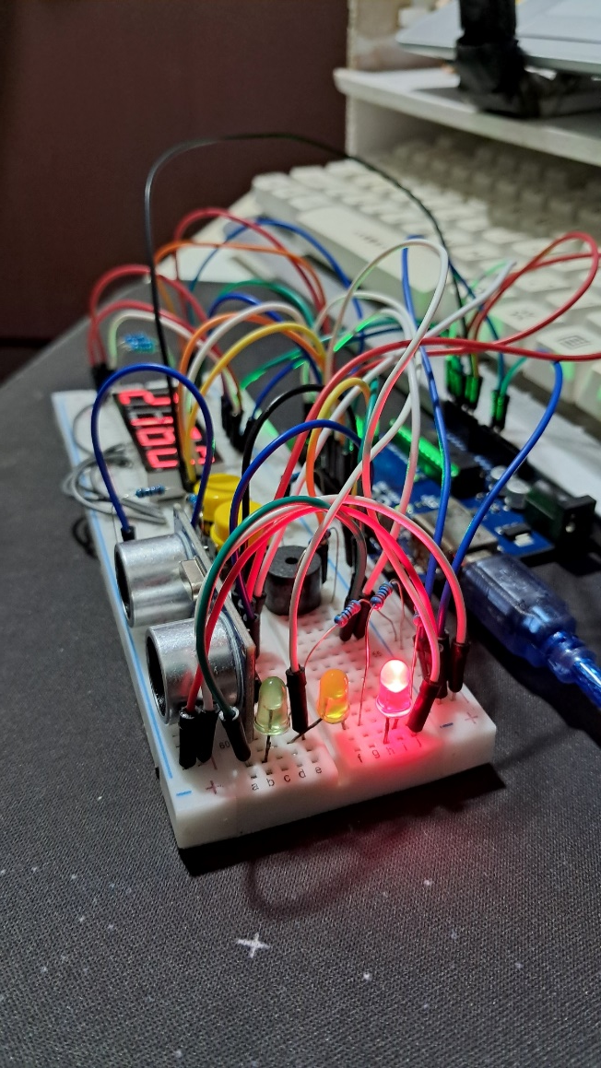
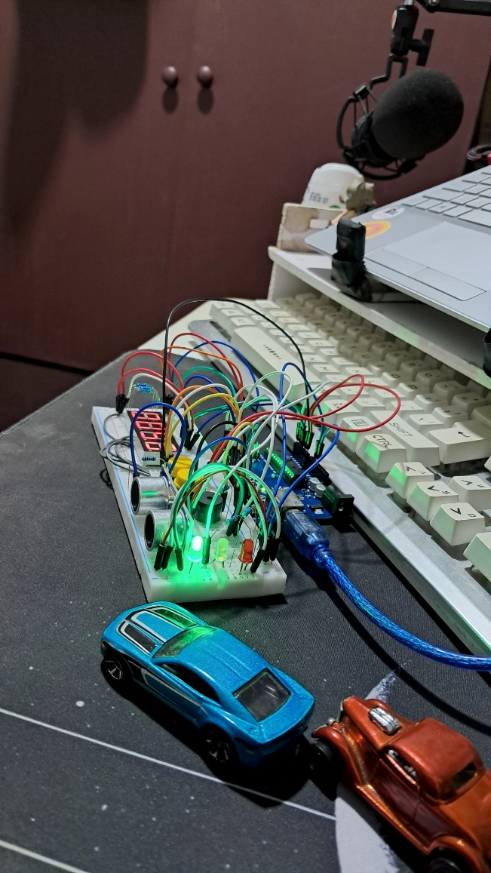
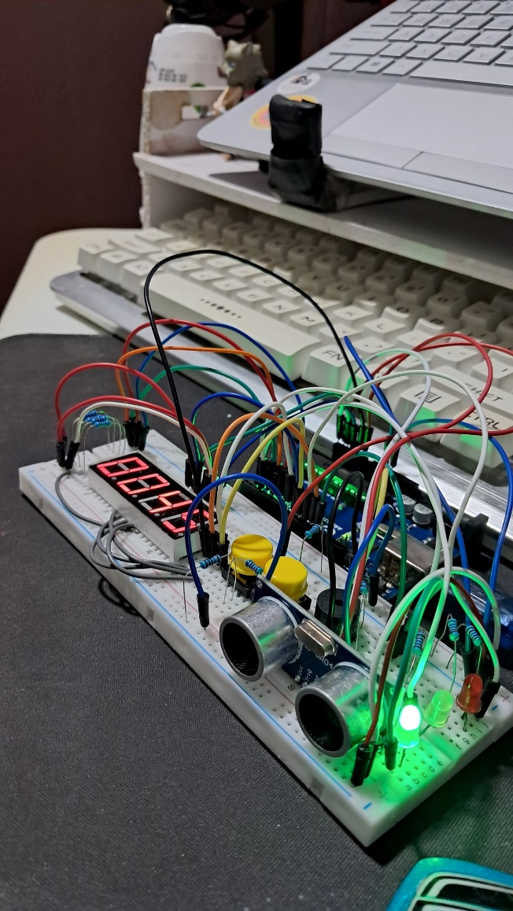
Final Output

Slide 7
THANK YOU!

